Slide 1
Quality of Service
Quality of Service (QoS) in networking refers to the capability of a network to provide different priority levels to different applications, users, or data flows, or to guarantee a certain level of performance to a data flow.
QoS mechanisms ensure that critical network traffic (such as real-time voice and video) gets preferential treatment over less critical traffic (such as file downloads), thereby optimizing the network's performance and efficiency.
Key Components:
Traffic Classification and Prioritization: QoS identifies and categorizes different types of traffic based on their application or service requirements. Traffic can be prioritized into different classes or queues to ensure that critical applications receive preferential treatment over less time-sensitive traffic.
Traffic Shaping and Policing: Traffic shaping controls the rate of traffic sent or received to ensure it conforms to specified traffic profiles. Policing involves monitoring and controlling the flow of traffic to enforce compliance with traffic agreements (such as bandwidth limits) set for different classes of traffic.
Congestion Management: Congestion management techniques manage network congestion by determining which packets to drop during periods of congestion or by prioritizing packets based on their importance and delay sensitivity.
500

Slide 2
Quality of Service-Key Components
Key Components :
Congestion Management: Managing network congestion by dropping or marking packets when the network is overloaded, prioritizing important traffic to minimize impact on critical applications.
Resource Reservation: QoS can allocate and reserve network resources such as bandwidth or buffer space to ensure that critical applications receive the necessary resources to maintain performance levels.
Monitoring and Management: QoS implementations include monitoring tools to measure and analyze network performance metrics related to latency, jitter, packet loss, and throughput. Network administrators can use this data to adjust QoS policies and improve overall network performance.
Packet Scheduling :Determining the order in which packets are transmitted when multiple packets are waiting to be sent, based on priority or other criteria.
Prioritization: Classifying traffic into different levels of importance based on parameters such as delay sensitivity, bandwidth requirements, and reliability.
Traffic Shaping: Controlling the rate of data transmission to smooth out bursts of traffic and maintain a steady flow, preventing congestion and packet loss.
500

Slide 3
Quality of Service-Benefits
Benefits of Quality of Service (QoS):
Improved Performance: QoS ensures that critical applications receive sufficient network resources, reducing delays and ensuring predictable performance.
Enhanced User Experience: Real-time applications like VoIP and video conferencing benefit from reduced latency and jitter, resulting in clearer audio and video quality.
Optimized Network Utilization: QoS allows efficient use of available network resources by prioritizing traffic based on its importance, reducing wasted bandwidth.
Support for Diverse Applications: QoS enables the coexistence of various applications on the same network infrastructure by managing traffic flows according to their specific requirements.
Prioritization: QoS allows network administrators to prioritize certain types of traffic over others. This ensures that critical applications, such as voice and video conferencing, receive sufficient bandwidth and low latency to operate smoothly.
500

Slide 4
Quality of Service-Benefits
Benefits of Quality of Service (QoS):
Reliability and Stability: QoS mechanisms can guarantee a minimum level of service quality for critical applications, even during periods of high network traffic or congestion. This reliability is crucial for maintaining productivity and communication in business environments.
Cost Efficiency: By optimizing resource allocation and ensuring efficient use of network capacity, QoS helps organizations achieve cost savings. It reduces the need for over-provisioning of bandwidth and infrastructure upgrades by making better use of existing resources.
Flexibility: QoS allows for flexibility in network management by enabling policies that can be adjusted based on changing traffic conditions, business priorities, and application requirements. This adaptability is essential in dynamic network environments.
Compliance and SLA Management: For service providers, QoS is often critical for meeting Service Level Agreements (SLAs) with customers. It provides the tools to enforce performance guarantees and ensure that contractual commitments regarding network performance are met.
500

Slide 5
Quality of Service-Parameters
Quality of Service (QoS) parameters refer to the specific metrics and attributes that define and govern the performance characteristics of network traffic. These parameters are used to manage and prioritize traffic according to the requirements of different applications and users.
Bandwidth: Bandwidth refers to the maximum data transfer rate of a network or internet connection. QoS mechanisms can allocate specific amounts of bandwidth to different types of traffic or applications to ensure they receive the necessary resources for optimal performance.
Latency: Latency, often referred to as delay, is the time it takes for a packet of data to travel from its source to its destination. Low latency is crucial for real-time applications like voice and video conferencing to maintain smooth and seamless communication.
Jitter: Jitter is the variation in packet arrival times at the destination. It can cause packets to arrive out of order, leading to disruptions in applications that require packets to be received in a specific sequence (e.g., streaming media). QoS mechanisms aim to minimize jitter to ensure consistent delivery of packets.
Packet Loss: Packet loss occurs when packets of data are dropped during transmission and do not reach their intended destination. QoS helps mitigate packet loss by prioritizing critical traffic and ensuring that network resources are managed efficiently to minimize the chances of congestion-related packet loss.
500

Slide 6
Quality of Service-Parameters
Reliability: Reliability refers to the consistency and predictability of network performance. QoS mechanisms can enforce policies to guarantee a certain level of service quality for critical applications, even under varying network conditions.
Throughput: Throughput is the actual rate of successful data transmission over a network connection. QoS can influence throughput by managing congestion, allocating bandwidth, and prioritizing traffic to optimize overall network efficiency.
Priority: QoS allows administrators to assign priorities to different types of traffic or applications based on their importance or sensitivity to delays. This ensures that critical applications receive preferential treatment during periods of congestion or limited resources.
Service Level Agreement (SLA) Compliance: QoS parameters are often defined in SLAs between service providers and customers. These parameters specify the expected levels of performance, such as minimum bandwidth, latency thresholds, and reliability guarantees, which QoS mechanisms must uphold.
Classification: Classification involves identifying and categorizing different types of traffic based on specific criteria (e.g., application type, source/destination address, protocol). QoS mechanisms use classification to apply appropriate policies and treatments to each type of traffic.
Policing and Shaping: QoS mechanisms include policing (enforcing traffic limits) and shaping (buffering and scheduling traffic) to regulate and control the flow of data through the network according to defined QoS parameters.
500

Slide 7
Quality of Service-Requirements
1. Latency : Real time applications <50ms (Eg VoIP, Video Conferencing)
Interactive applications <100 ms(Online gaming, Virtual reality)
2. Bandwidth : High definition video streaming: 5-10 Mbps
Standard Video streaming : 1-5 Mbps
Audio streaming: 32-128kbps
Online gaming:1-5 Mbps
3. Jitter
Real time applications <10 Ms
Interactive applications<20 Ms
Non interactive applications<50 Ms
500

Slide 8
Quality of Service-Requirements
4. Packet loss
Real time applications<1 %
Interactive applications<2%
Non interactive applications<50 Ms
5. Priority
Critical applications : Emergency Services, High Priority
Non-Real-Time applications: Medium-low priority
6 Reliability
High availability-99.99% for critical applications
7 Security
500

Slide 9
Quality of Service-Requirements
Application | Reliability | Delay | Jitter | Bandwidth
E-mail | High | Low | Low | Low
File Transfer | High | Low | Low | Medium
Web access | High | Medium | Low | Medium
Remote Login | High | Medium | Medium | Low
Audio on Demand | Low | Low | High | Medium
Video on Demand | Low | Low | High | High
Telephony | Low | High | High | Low
Videoconferencing | Low | High | High | High
500

Slide 10
Quality of Service-Requirements
The first 4 applications provides high reliability and uses check sum at the destination for packet verification.
The last 4 applications can tolerate errors, so no check sums are computed or verified.
File transfer, email, and video applications are not delay case sensitive.
Web surfing, remote login, telephony and videoconferencing applications are delay case sensitive.
ATM networks classify flows in 4 categories wrt QoS demand:
Constant bit rate- Telephony
Real time variable bit rate – Compressed Video conferencing
Non real time variable bit rate- Watching a movie over the Internet
Available bit rate- File transfer
500

Slide 11
Quality of Service-Techniques
Traffic policing : Discards or delays packets that exceed a specified rate
Queue management: Manages packet queues to prevent congestion
Resource reservation: Reserves network resources for specific applications.
QoS is essential for applications requiring low latency, high throughput and reliability
Real-time video streaming
Voice over IP(VoIP)
Online gaming
Virtual reality
Mission critical communications
500

Slide 12
Quality of Service-Techniques
Overprovisioning: Practice of allocating more resources including Bandwidth, memory, Processing power actually needed to handle the expected workload or traffic in a network or system.
Buffering: Practice of storing the data in a temporary storage to manage data flow and improve performance in various contexts such as Networking, Video streaming, Audio processing, Computer Graphics.
It helps data flow and congestion
Reduce latency and lag
Improve performance and throughput
Improves reliability and accuracy
Compensate for variations in data rates or processing speeds.
Techniques: FIFO, LIFO, Circular buffers, Double Buffering, Multi Buffering.
500

Slide 13
Quality of Service-Techniques
Traffic Shaping: Regulates the rate of data transmission to ensure that it conforms to a specific bandwidth or speed limit.
Prevent network congestion, reduce latency and Guarantee QoS
Monitoring incoming data traffic
Buffering excess packets
Releasing packets at a controlled rate
Traffic shaping is commonly used in Network routers, switches, WAN links, ISP networks,
Enterprise networks and
Real time applications.
Algorithms – Leaky Bucket, Token Bucket
500

Slide 14
Congestion Control Algorithms
Leaky Bucket Algorithm :
The leaky bucket algorithm discovers its use in the context of network traffic shaping or rate-limiting.
This algorithm is used to control the rate at which traffic is sent to the network and shape the burst traffic to a steady traffic stream.
The bucket has a maximum capacity –Bucket size
If the bucket is full, excess packets are discarded.
The bucket drains at a constant rate.
Key parameters : Bucket Size (BS), Drain rate(DR), Fill rate (FR)
Helps to limits the average data rate, regulate the bursty traffic, Prevent Network Congestion, Ensure fair sharing bandwidth.
500

Slide 15
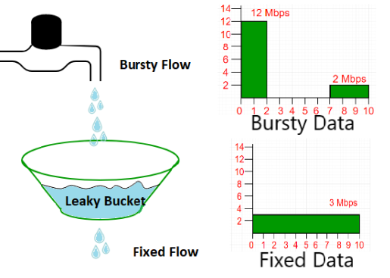
Leaky Bucket Algorithm
Each network interface contains a leaky bucket and the following steps are involved in leaky bucket algorithm:
When host wants to send packet, packet is thrown into the bucket.
The bucket leaks at a constant rate, meaning the network interface transmits packets at a constant rate.
Bursty traffic is converted to a uniform traffic by the leaky bucket.
In practice the bucket is a finite queue that outputs at a finite rate.
Assume that the network has committed
a bandwidth of 3 Mbps for a host.
The use of the leaky bucket shapes the input traffic to make
it conform to this commitment.
The host sends a burst of data at a rate of 12 Mbps for 2s, for a total of 24 Mbits of data.
The host is silent for 5 s and then sends data at a rate of 2 Mbps for 3 s, for a total of 6 Mbits of data.
Totally, the host has sent 30 Mbits of data in 10s.
The leaky bucket smooths out the traffic by sending out data at a rate of 3 Mbps during the same 10s.
500

Slide 16
Leaky Bucket Algorithm
A simple leaky bucket algorithm can be implemented using FIFO queue. A FIFO queue holds the packets.
If the traffic consists of fixed-size packets (e.g., cells in ATM networks), the process removes a fixed number of packets from the queue at each tick of the clock.
If the traffic consists of variable-length packets, the fixed output rate must be based on the number of bytes or bits.
Algorithm for variable-length packets:
Initialize a counter to n at the tick of the clock.
Repeat until n is smaller than the packet size of the packet at the head of the queue.
Pop a packet out of the head of the queue, say P.
Send the packet P, into the network
Decrement the counter by the size of packet P.
500

Slide 17
Leaky Bucket Algorithm
Example: Bucket size is 100 MB, DR 80 Mbps, FR Incoming data rates.
Incoming data rate is 150 MB
Bucket fills only 100 MB
Excess date 50 MB is Discarded
Bucket drains out 80 MB
Remaining data 20 MB in bucket
Next incoming data burst will add to the bucket.
500

Slide 18
Leaky Bucket Algorithm
// cpp program to implement leakybucket #include <bits/stdc++.h> using namespace std; int main() {int no_of_queries, storage, output_pkt_size; int input_pkt_size, bucket_size, size_left; // initial packets in the bucket storage = 0; // total no. of times bucket content is checked no_of_queries = 4; // total no. of packets that can // be accommodated in the bucket bucket_size = 10; // no. of packets that enters the bucket at a time input_pkt_size = 4; // no. of packets that exits the bucket at a time output_pkt_size = 1; for (int i = 0; i < no_of_queries; i++) // space left { size_left = bucket_size - storage; if (input_pkt_size <= size_left) { // update storage storage += input_pkt_size; } else { printf("Packet loss = %d\n", input_pkt_size); } printf("Buffer size= %d out of bucket size= %d\n", storage, bucket_size); storage -= output_pkt_size; } return 0; }
500

Slide 19
Token Bucket Algorithm
The Token Bucket algorithm is a popular and simple method used in computer networking and telecommunications for traffic shaping and rate limiting.
It is designed to control the amount of data that a system can send or receive in some sort of period, ensuring that the traffic conforms to a specified rate.
It refers to traffic control mechanisms that seek to either differentiate performance based on application or network-operator requirements or provide predictable or guaranteed performance to applications, sessions, or traffic aggregates. It is something that data flow seeks to attain.
Need for Token Bucket Algorithm :
Video and audio conferencing require a bounded delay and loss rate.
Video and audio streaming requires a bounded packet loss rate, it may not be so sensitive to delay.
A critical applications (real-time control) in which bounded delay is considered to be an important factor.
Valuable applications should provide better services than less valuable applications.
500

Slide 20
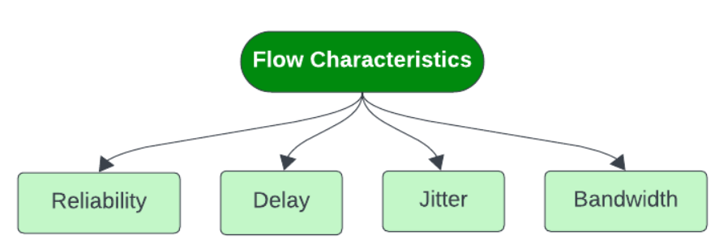
Token Bucket Algorithm- Characteristics
500

Slide 21
Token Bucket Algorithm- Characteristics
Reliability
It implies packet reached or not, information lost or not. Lack of reliability means losing a packet or acknowledgement, which entails re-transmission. Reliability requirements may differ from program to program. For example, it is more important that electronic mail file transfer and internet access have reliable transmissions than telephony or audio conferencing.
Delay
It denotes source-to-destination delay. Different applications can tolerate delay in different degrees. Telephony, audio conferencing, video conferencing, and remote log-in need minimum delay, while delay in file transfer or e-mail is less important.
Jitter
Jitter is the variation in delay for packets belonging in same flow. High jitter means the difference between delays is large; low jitter means the variation is small. For example, if packets 0,1,2,3s arrive at 6,7,8,9s it represents same delay. Jitter would signify that packets departed at 0,1,2,3s reach destination at 4,6,10,15s. Audio and video applications don’t allow jitter.
Bandwidth
Different applications need different bandwidths. In video conferencing we need to send millions of bits per second to refresh a color screen while the total number of bits in an e-mail may not reach even a million.
500

Slide 22
Token Bucket Algorithm
Imagine a bucket that holds tokens, each representing a unit of data i.e bytes or packets.
The bucket is filled with tokens at a constant rate
Each incoming data packet requires a token to be transmitted.
If the bucket is empty, packets are buffered or discarded
The bucket has a maximum capacity.
How it works :
Incoming packets are checked against the token bucket depth
If sufficient tokens are available, the packet is transmitted and tokens are removed from the bucket
If the bucket is empty, packets are buffered or discarded
The token bucket is continuously filled at the token rate
500

Slide 23
Token Bucket Algorithm
Key parameters : Token rate , Bucket size (Maximum no of tokens in the Bucket) Token bucket depth (Number of tokens in the Bucket).
Limits the average data rate
Regulates bursty traffic
Prevents network congestion
Ensures fair sharing of bandwidth.
500

Slide 24
Token Bucket Algorithm
Example-Token Bucket Algorithm
Token rate (TR) =100 Tokens / second
Bucket size(BS)= 1000 Tokens
Incoming data rate =150 tokens / second (Bursty traffic)
Initially the bucket is full 1000 tokens
150 tokens are removed from the bucket
Bucket depth=850 tokens
100 tokens are added
Bucket depth is 950 tokens
500

Slide 25
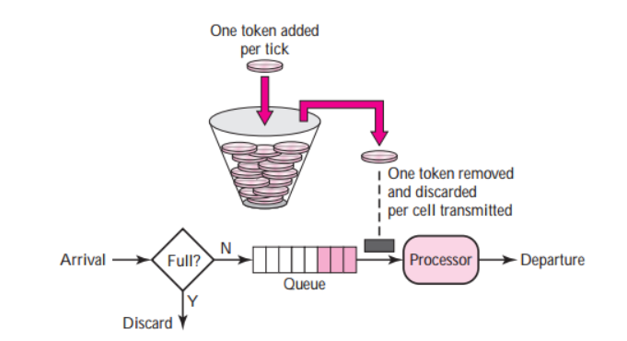
Token Bucket Algorithm-Working
It allows bursty traffic at a regulated maximum rate. It allows idle hosts to accumulate credit for the future in the form of tokens. The system removes one token for every cell of data sent. For each tick of the clock the system send n tokens to the bucket. If n is 100 and host is idle for 100 ticks, bucket collects 10000 tokens. Host can now consume all these tokens with 10 cells per tick.
Token bucket can be easily implemented with a counter. The token is initiated to zero. Each time a token is added, counter is incremented to 1. Each time a unit of data is sent, counter is decremented by 1. When the counter is zero, host cannot send data.
500

Slide 26
Token Bucket Algorithm- Limitations
Token Bucket has the tendency to generate tokens at a fixed rate, even when the network traffic is not present. This is leads of accumulation of unused tokens during times when there is no traffic, hence leading to wastage.
Due to token accumulation, delays can introduced in the packet delivery. If the token bucket happens to be empty, packets will have to wait for new tokens, leading to increased latency and potential packet loss.
Token Bucket happens to be less flexible than leaky bucket when it comes to network traffic shaping. The fixed token generation rate cannot be easily altered to meet changing network requirements, unlike the adaptable nature of leaky bucket.
The implementation involved in token bucket can be more complex, especially due to the fact that different token generation rates are used for different traffic types. Configuration and management might be more difficult due to this.
Usage of large bursts of data may lead to inefficient use of bandwidth, and may cause congestion. Leaky bucket algorithm, on the other hand helps prevent congestion by limiting the amount of data sent at any given time, promoting more efficient bandwidth utilization.

Slide 27
Token Bucket Vs Leaky Bucket
Token Bucket Algorithm | Leaky Bucket Algorithm
It depends on tokens. | It does not depend on tokens.
If bucket is full, token is discarded but not the packet. | If bucket is full, then packets are discarded.
Packets can only transmit when there are enough tokens. | Packets are transmitted continuously.
Allows large bursts to be sent at faster rate. Bucket has maximum capacity. | Sends the packet at a constant rate.
The bucket holds tokens generated at regular intervals of time. | When the host has to send a packet , packet is thrown in bucket.
If there is a ready packet , a token is removed from Bucket and packet is send. | Bursty traffic is converted into uniform traffic by leaky bucket.
If there is no token in the bucket, then the packet cannot be sent. | In practice bucket is a finite queue outputs at finite rate.

Slide 28
Leaky Bucket-Problem
Problem-1
In a leaky bucket system if the output rate is 5 KB/sec and input burst of 50 KB/sec for 10 sec and 10 KB/sec for 50 sec then bucket size in KB is ?
Input burst = 50KB/sec for 10 sec and 10KB/sec for 50sec.
Output rate = 5KB/sec
Total time = 60sec ,Total Length = 500KB + 500KB = 1000KB.
Now output rate = 5KB ------ 1 sec
? ------ 60sec
In 60sec we can transmit 300KB.
We should have a Bucket of size 1000KB - 300KB = 700KB

